Slide 1



AI Governance in K-12 Public Schools
Building a Statewide Baseline for Responsible Local AI Policies
Fang Gong
Livingston Board of Education Member
JerseyCAN Parent Fellow | Parent
Notes:
Good morning, My name is Fang Gong. I am a Livingston Board of Education member, a parent of two elementary school students, and a JerseyCAN Parent Fellow.
For this fellowship, I chose the Innovation category and focused on AI governance in K–12 public schools — because New Jersey needs a statewide baseline so every district can guide AI use responsibly.”

Slide 2
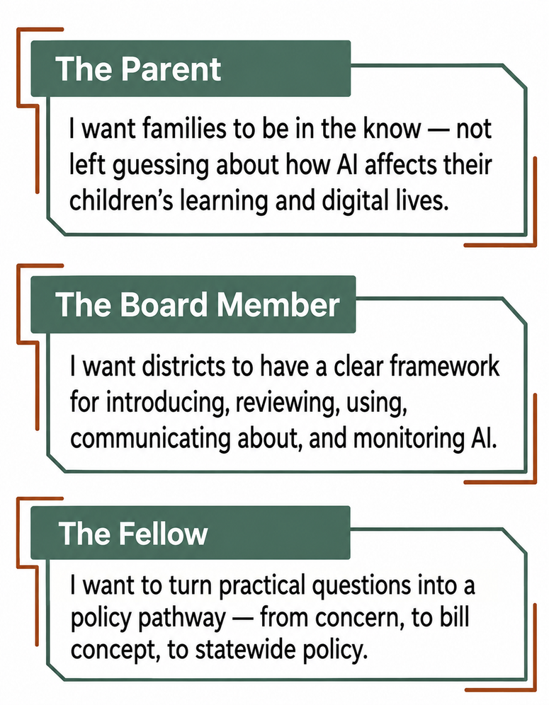
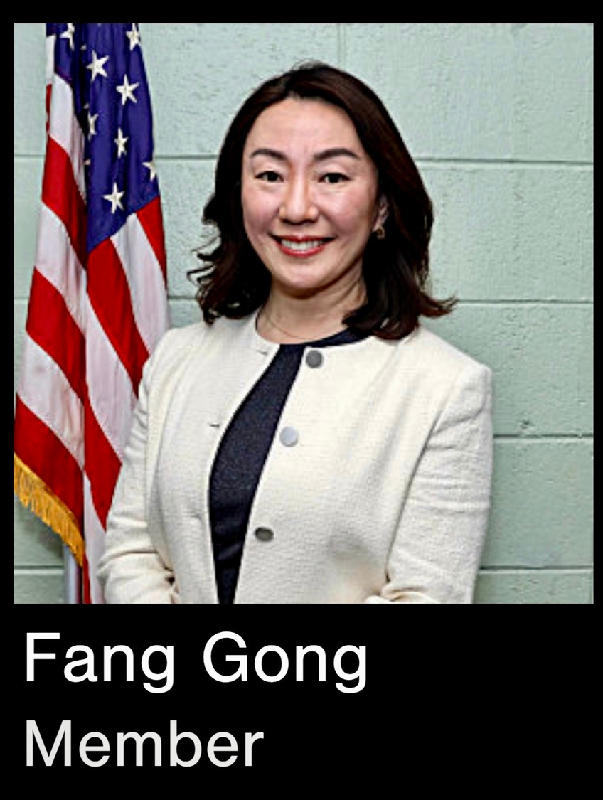
My Three Hats: Why I joined
Notes:
This project came from three roles I carry at the same time.
As a parent, I want families to be in the know.
As a board member, I want to better understand how districts should guide AI use.
As a JerseyCAN Fellow, I wanted to turn those questions into policy — a statewide policy requirement for local AI governance.”

Slide 3

My Advocacy:
AI is entering our schools in many ways, and while New Jersey is responding one leak at a time, my advocacy asks for the stronger roof: a statewide baseline for local AI governance policies based on: Transparency | Equity | Ethics.

Slide 4
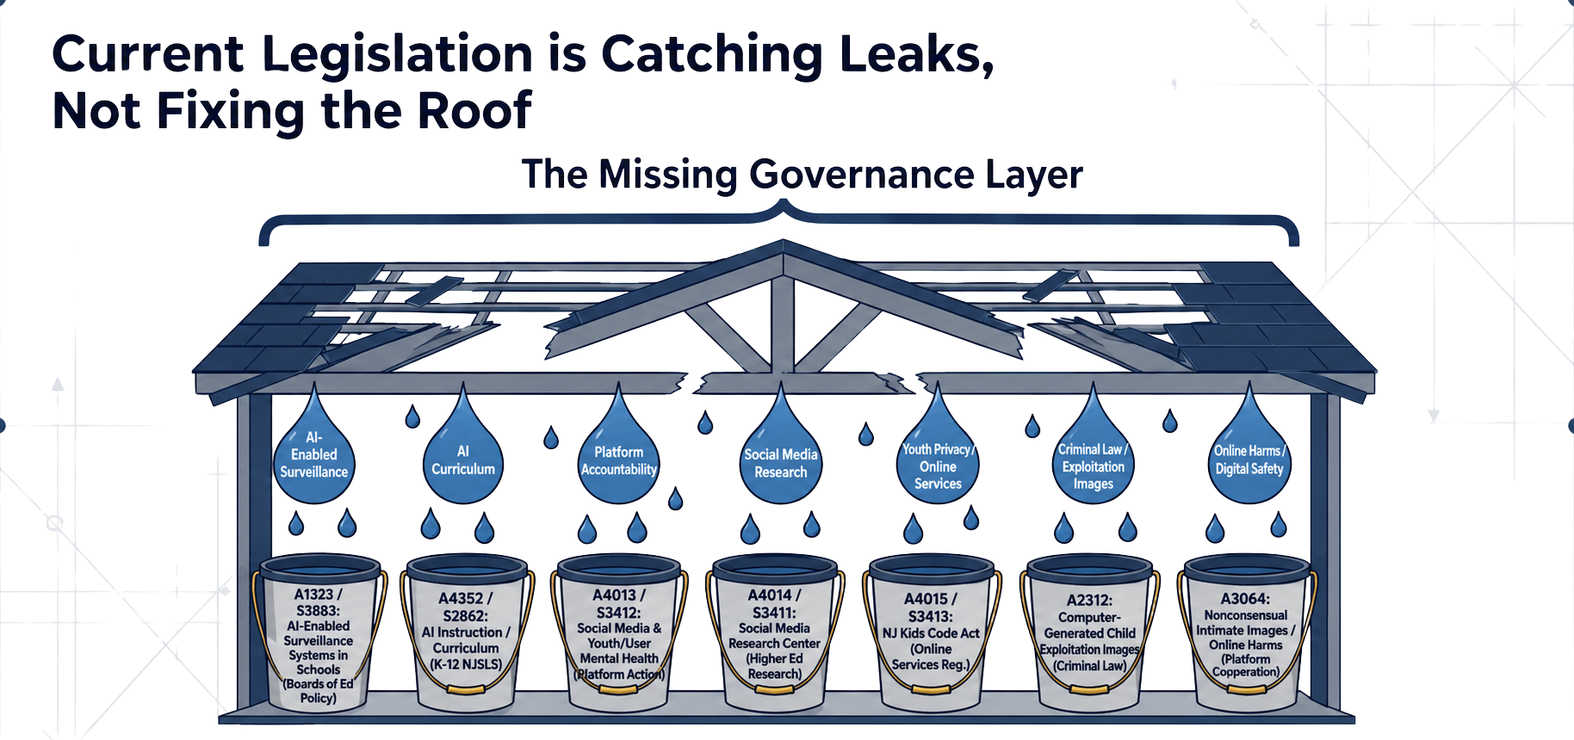
Innovation is Outpacing Governance

Slide 5

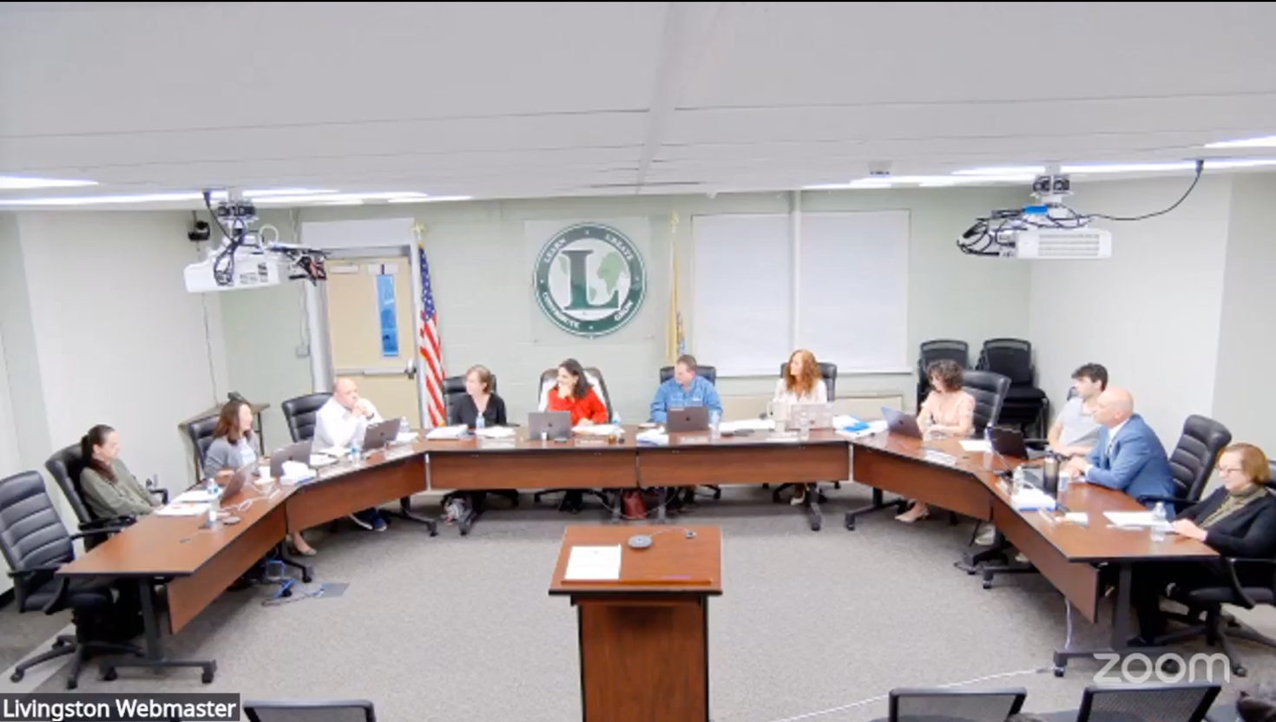
Theory of Action
If...
Then...
So that...
every New Jersey school district is required to adopt a local AI governance policy,
districts will have a clear public-facing framework for how AI is introduced, reviewed, used, communicated about, and monitored
students are protected, families are informed, educators are supported, and AI use remains grounded in:
Transparency | Equity | Ethics
Notes:
SAMPLES:
Topic 1 – Recruiting and Retaining High-Quality Educators
Theory of Action:
If we intentionally recruit, support, and retain a pool of high-quality educators,
then educators will be better equipped to address students’ academic needs,
so that all students can reach their full potential.
Topic 2 – Ensuring High-Quality, Research-Based Literacy Instruction in Early Childhood
Theory of Action:
If we ensure that early childhood educators are trained and supported in implementing structured, evidence-based literacy practices,
then students will develop strong foundational literacy skills in the critical early years of learning,
so that every child, regardless of background, has an equitable opportunity to become a confident, proficient reader by third grade.
Topic 3 – Promoting Innovative Programs (e.g., Dual Enrollment, Virtual Learning)
Theory of Action:
If we expand access to innovative programs such as dual enrollment, career and technical education (CTE), and virtual learning for historically underserved student populations,
then students will have greater access to rigorous coursework, college credit, and flexible learning pathways,
so that all students can pursue postsecondary success and lifelong learning opportunities, regardless of geographic or economic barriers.

Slide 6


Advocacy Work
March 25
April 15
May 8
May 10
May 13
May 28
Held Zoom meeting with Chief of Staff and mentor Scott to refine strategy and language
A5184 (Bagolie) was submitted for introduction
Presented request to Assembly-woman Bagolie
Concept accepted and sent to OLS for drafting
Drafted one-page brief and outline
Submitted Bill Concept Memo

Slide 7

Navigating the Curves
Curve 1: Three Pillars, Not “Just Tech”
Transparency, equity, and ethics were easy to name, but harder to explain in AI governance.The challenge was keeping the proposal from being reduced to a single-issue patch.
Back on route:
Added explanatory language so OLS could understand the full intent.
Curve 2: Requirement vs. Policy
My original ask focused on a statewide requirement. The Assemblywoman’s office clarified that the requirement had to be tied to policy language.
Back on route:
Reframed the ask as a statewide policy requirement for local AI governance.

Slide 8
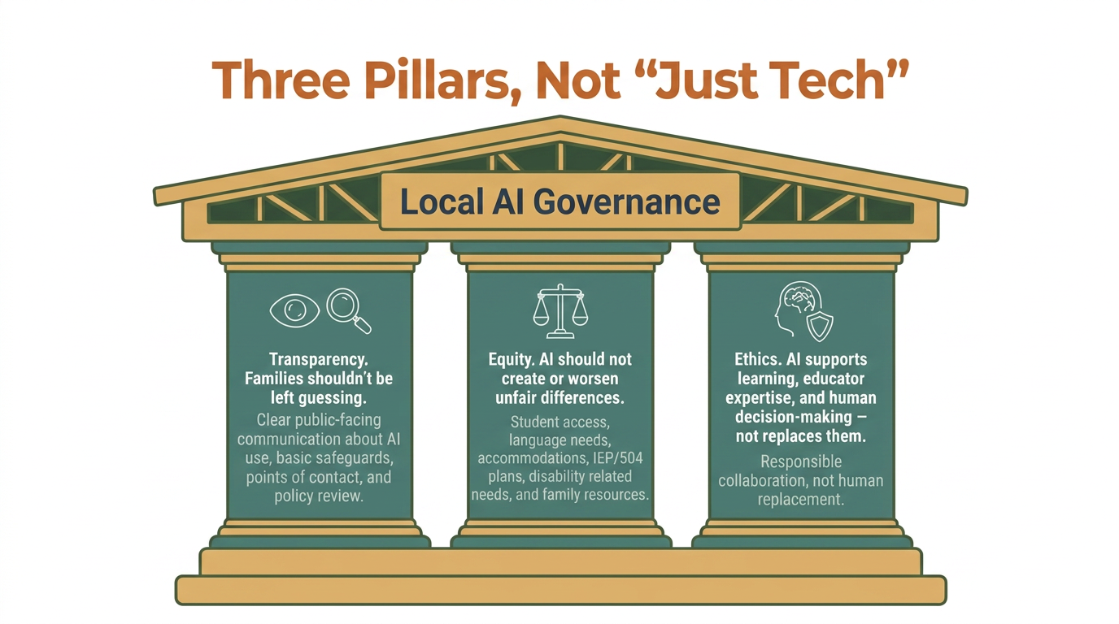

Slide 9
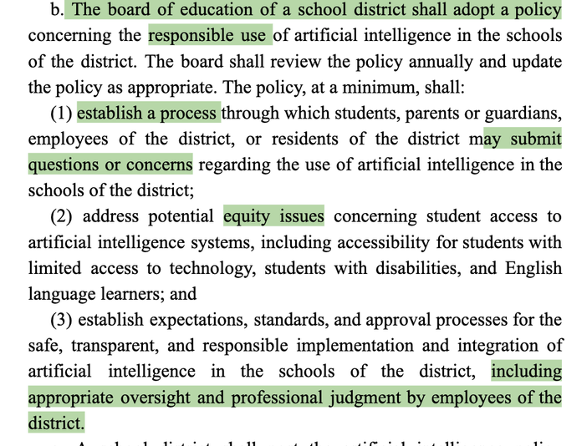

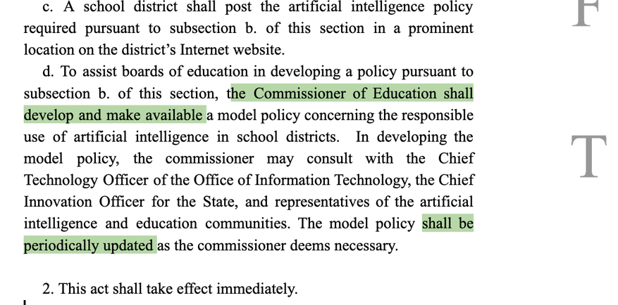
Outcome:
From Policy Concept to Draft Legislation
A5184 was submitted for introduction on May 28, 2026. Public release on the NJ Legislature website expected on June 1, 2026.
Success measure:
Observation → Questions → Memo → Legislative Review → OLS Drafting and Editing→ Bill submitted for Introduction
Scan the QR Code to view my Bill Concept Memo
https://drive.google.com/file/d/1ULDNb-AK9Gj03a2PwNXyWJ82YUtKyRri/view?usp=drive_link

Slide 10





Personal Next Steps
  Continue the advocacy
Track A5184 after public release, committee referral, and Senate-side coordination.
  Keep learning the policy-to-practice pathway
Understand how a statewide policy requirement connects with NJDOE guidance, model policy support, local BOE adoption, and district practice.
  Bring it back locally
Use this experience to ask stronger AI governance questions as a BOE member and parent.
  Hope for the future
Every New Jersey district has a clear, human-centered AI governance policy grounded in transparency, equity, and ethics.
  Closing line:
AI should not simply happen to schools — we must guide it with responsibility.

Slide 11


Biggest Fellowship Takeaway
Communication is the key
  Listen carefully.
  Express clearly.
  Persuade respectfully.
  Stay open to clarification.
At the heart of advocacy
is something deeply human.
My Blinq Card

